Slide 1



SETTING UP DEVELOPMENT ENVIRONMENT FOR HIBERNATE
Chapter 4

Slide 2
Today’s Agenda
Setting Up The System
Softwares Required
Downloading Hibernate Jar Files

Slide 3
Softwares Required
In order to develop Hibernate based applications our system should have 5 softwares:
The JDK
An IDE , preferably Eclipse
A Database Management System ( Oracle , MySQL etc )
Hibernate Jar Files
Database Driver Jar File

Slide 4
Softwares Required
Hibernate works best with JDK 8 or 11 , although the latest version of Java can also be used.
Similarly , any Java IDE like Eclipse , Netbeans or IntelliJ Idea can be used . However we in this course would be using Eclipse.
We will be discussing all the examples by using Oracle as our backend.
Again , it doesn’t matter which RDBMS we use as all the steps we will code will always remain same irrespective of the RDBMS used.

Slide 5
Installing Hibernate
Any framework software is not an installable software.
This means we do not have to run any setup.exe file.
Working with the framework software requires just 2 steps:
downloading the jar files provided by that framework
adding the .jar(s) files to our Java application’s classpath

Slide 6
Installing Hibernate
When we download any framework software, we will get a “zip” file and we need to unzip it.
Actually all framework softwares follow same common principle:
Framework software will be in the form of a set of jar files.
Here one jar file acts as main (We can call this file as core) and remaining will acts as dependent jar files.
In our case, this main jar file is hibernate-core

Slide 7
Installing Hibernate
To download jars follow the below steps :
Go to : http://hibernate.org/orm/releases/
From the above URL click on stable 5.4 final
On the page that opens scroll down to release in this series→5.4.21 final→download
Within a short span of time the download will start and when the download finishes we will get a file called hibernate-release-5.4.21.Final.zip

Slide 8
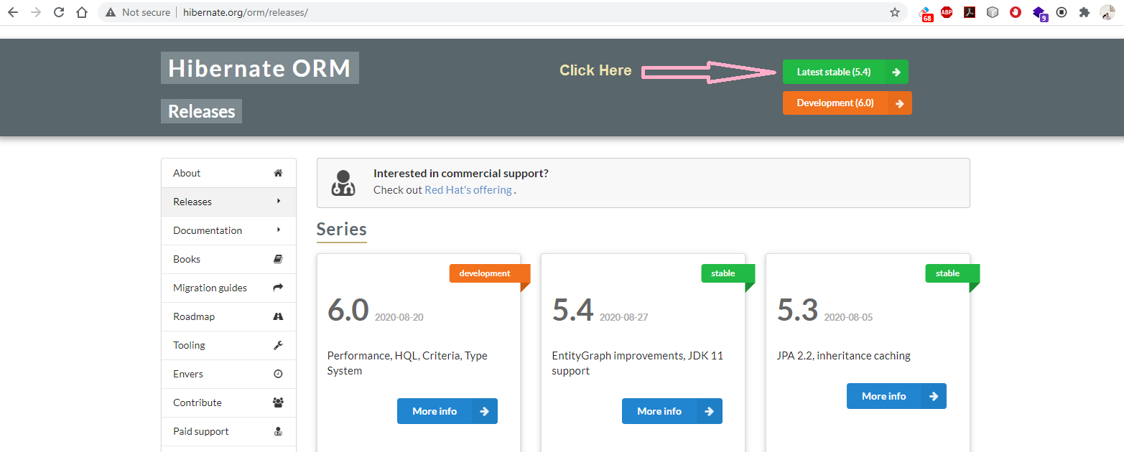
Installing Hibernate

Slide 9
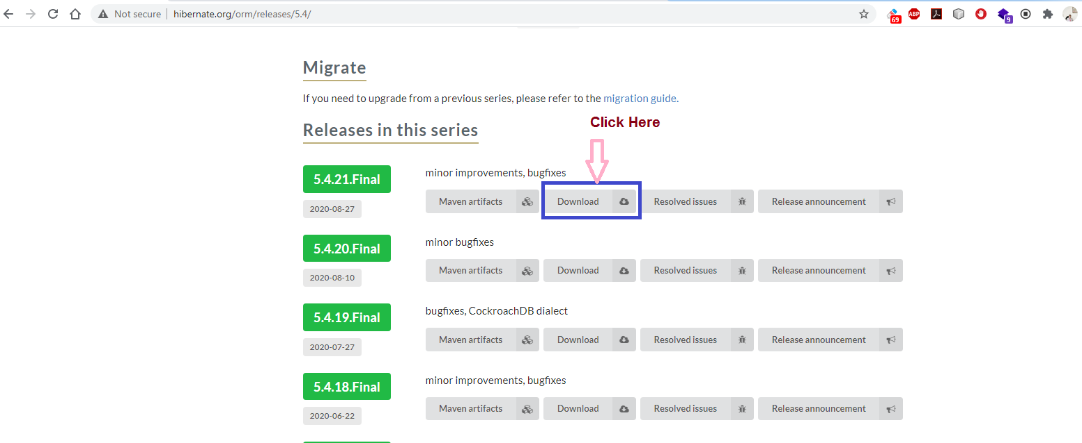
Installing Hibernate

Slide 10
Installing Hibernate
Unzip the file hibernate-release-5.4.21.Final.zip to a folder called hibernate-release-5.4.21.Final
Inside this folder we will find a lib/required folder containing all the jar files of hibernate
Now when we will create our hibernate app in Eclipse then we will have to copy these jar files to the build path of our application in Eclipse.
Also we will require jar file of our database driver which for Oracle will be either ojdbc6.jar or ojdbc14.jar or classes12.jar depending on our Oracle version

